Slide 1


Dev-Pro Node.js
Advanced Flow
Lesson 6. GC and Relational vs Document Oriented.

Slide 2

Agenda:
Node GC Explanation
Memory leaks in node
Relational databases vs Document oriented
Top 5 node ORM/ODM

Slide 3


Garbage collector

Slide 4
Application-level memory management can be manual or automatic.
The automatic memory management usually involves a garbage collector.

Slide 5
Memory Management in Node.js

Slide 6
In manual memory management, it is the responsibility of the developer to free up the unused memory portions. Managing your memory this way can introduce several major bugs to your applications:
Memory leaks when the used memory space is never freed up.
Wild/dangling pointers appear when an object is deleted, but the pointer is reused.
Serious security issues can be introduced when other data structures are overwritten or sensitive information is read.

Slide 7
Luckily for you, Node.js comes with a garbage collector, and you don't need to manually manage memory allocation.

Slide 8
The way how the GC knows that objects are no longer in use is that no other object has references to them.

Slide 9
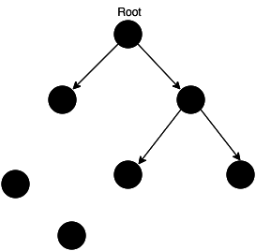
Memory before GC

Slide 10
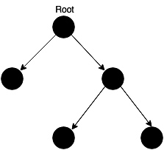
Memory after GC

Slide 11

ADVANTAGES OF USING GC
Prevents wild/dangling pointers bugs
won't try to free up space that was already freed up
protect you from some types of memory leaks

Slide 12
THINGS TO
KEEP IN MIND
PERFORMANCE
UNPREDICTABLE STALLS
in order to decide what can be freed up, the GC consumes computing power
modern GC implementations try to avoid "stop-the-world" collections

Slide 13
THE STACK

Slide 14
THE HEAP

Slide 15
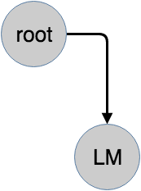
THE HEAP

Slide 16
THE HEAP

Slide 17
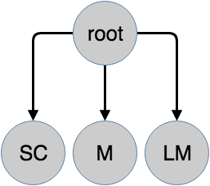
THE HEAP

Slide 18
THE HEAP

Slide 19
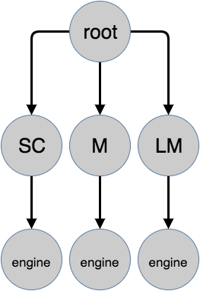
THE HEAP

Slide 20

THE HEAP

Slide 21
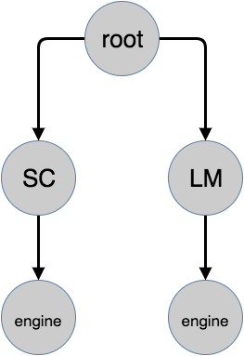
THE HEAP

Slide 22
New Space and Old Space
The heap has two main segments, the New Space and the Old Space. The New Space is where new allocations are happening; it is fast to collect garbage here and has a size of ~1-8MBs. Objects living in the New Space are called Young Generation.
The Old Space where the objects that survived the collector in the New Space are promoted into - they are called the Old Generation. Allocation in the Old Space is fast, however collection is expensive so it is infrequently performed .

Slide 23
Young Generation
Usually, ~20% of the Young Generation survives into the Old Generation. Collection in the Old Space will only commence once it is getting exhausted. To do so the V8 engine uses two different collection algorithms.

Slide 24
Memory leaks

Slide 25
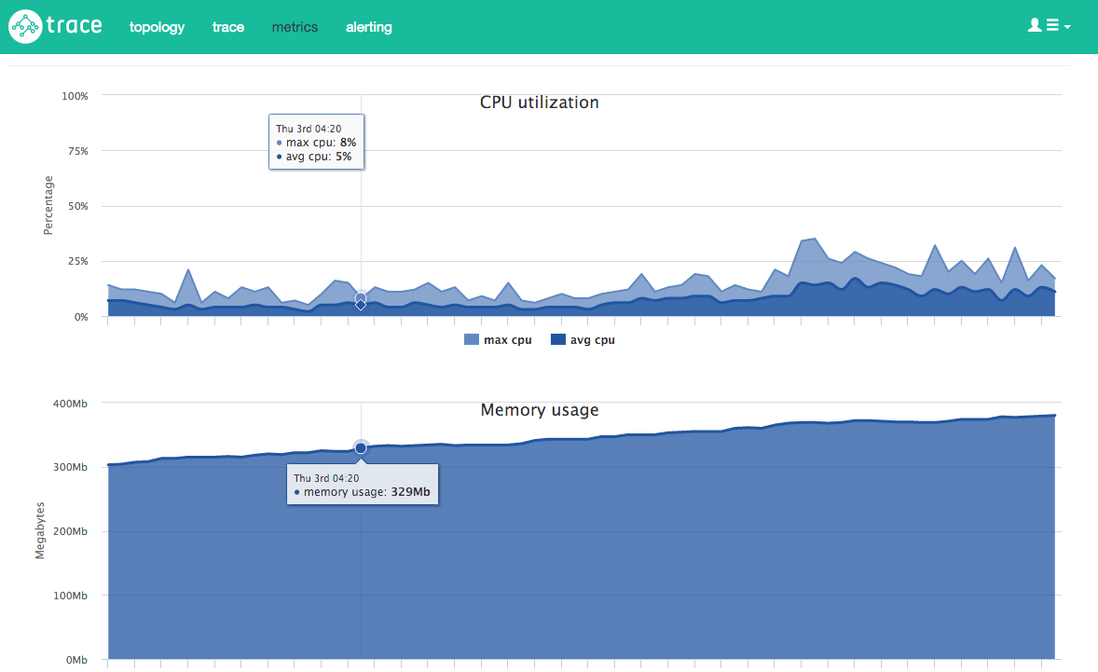
Profiling

Slide 26
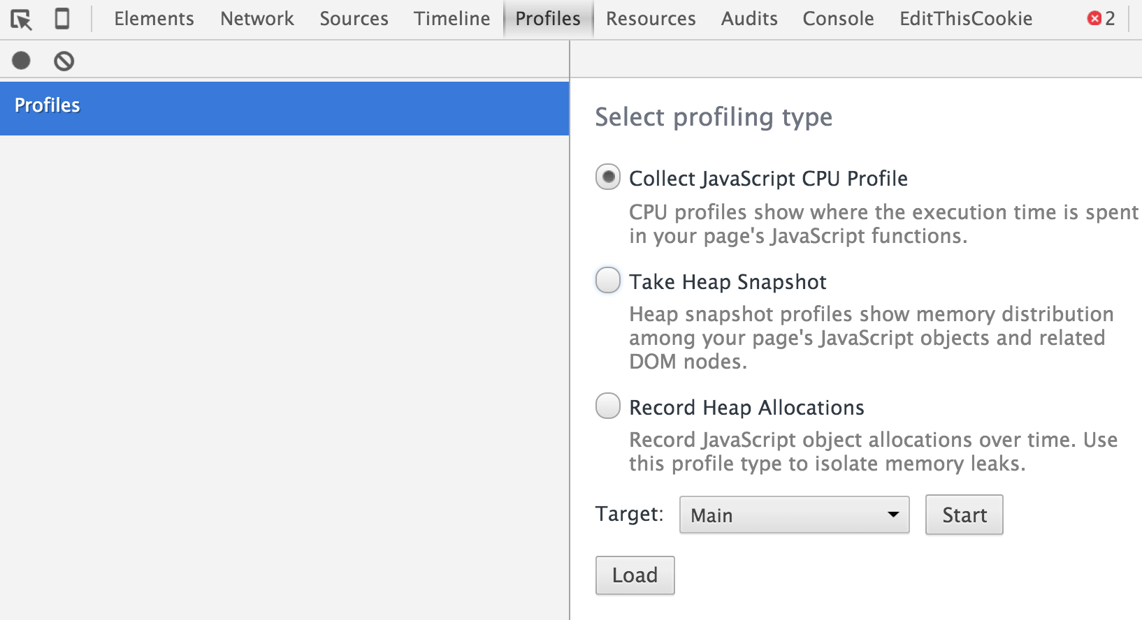
Profiling

Slide 27
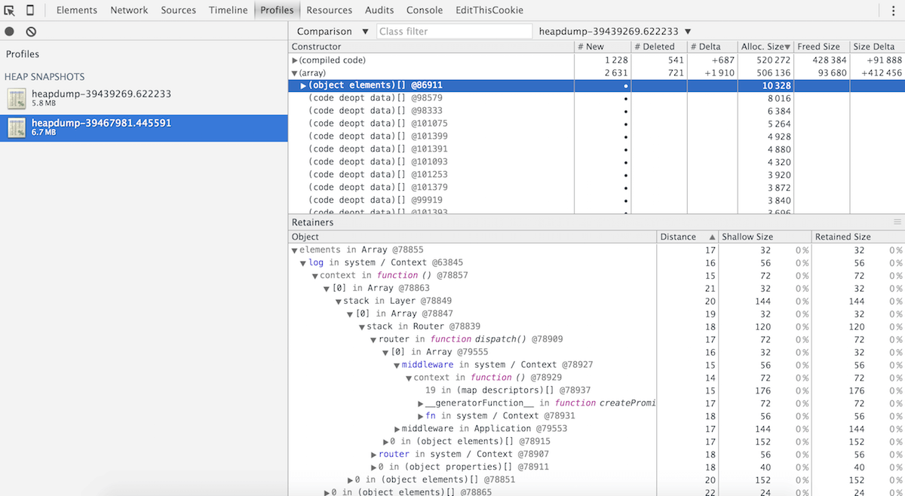
Profiling

Slide 28
Node profiling

Slide 29
Node profiling

Slide 30

RDBMS vs Document Oriented

Slide 31

TOP-5 : Mongoose

Slide 32

TOP-5 : Sequileze

Slide 33
TOP-5 : Bookshelf

Slide 34

TOP-5 : Waterline

Slide 35

TOP-5 : Type ORM

Slide 36

Let’s Holly War Start!

Slide 37
Thank you for attention

